Slide 1
EU Enlargement–
A business perspective
Asees Ahuja, Director EU Policy

Slide 2
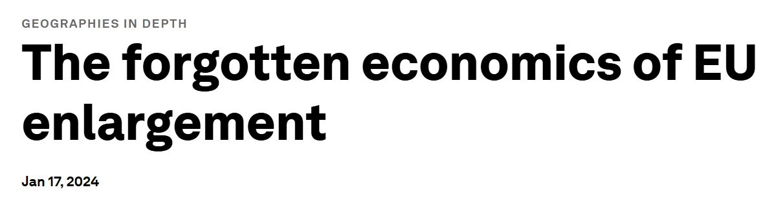

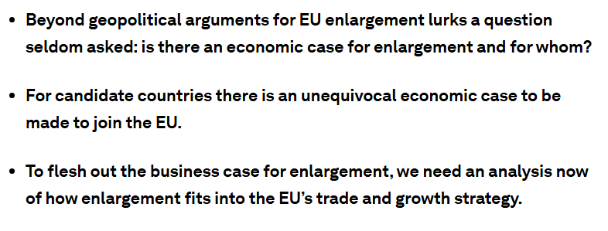


A business perspective is missing

Slide 3
Why is Swedish Enterprise interested in EU enlargement?
Development in Swedish exports and imports from Ukraine, other candidates and the rest of the world 2014-2023

Slide 4
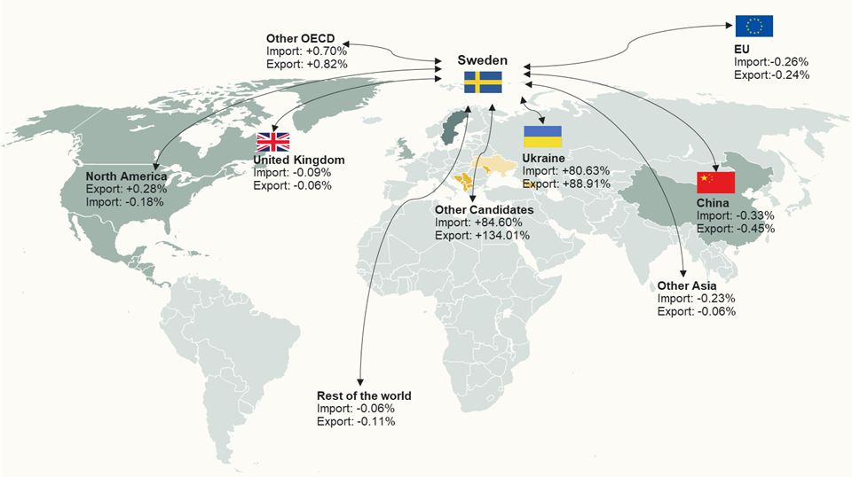
Enlargement is an important part of diversification

Slide 5
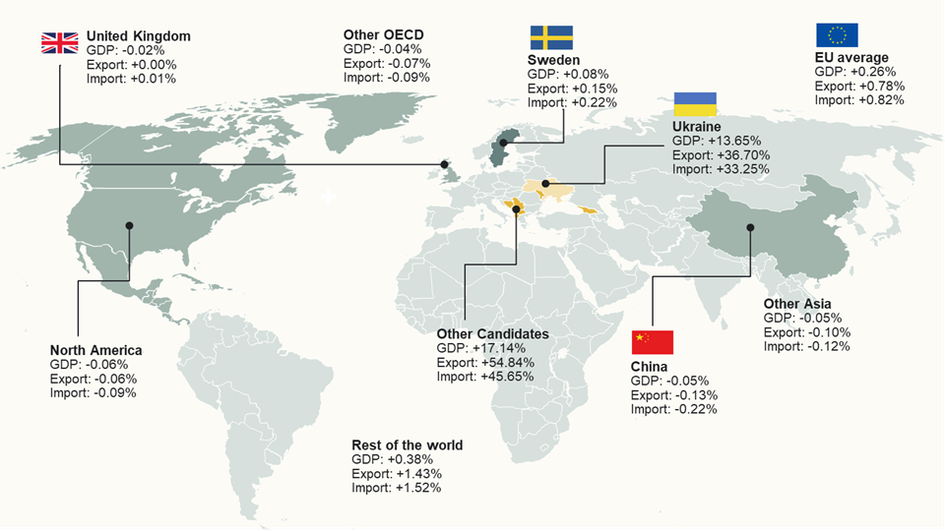
And is an important part of Europe’s Growth story

Slide 6
6
Swedish companies are still cautious
Do you or have you considered doing business with any of the following countries applying for EU membership?

Slide 7
2026-06-09
7
Companies want to see reforms in candidate countries
What would make your company expand its business activities in the candidate countries?

Slide 8
2026-06-09
8
EU membership matters most to investors and services
Would EU membership make your company more interested in the candidate countries?

Slide 9
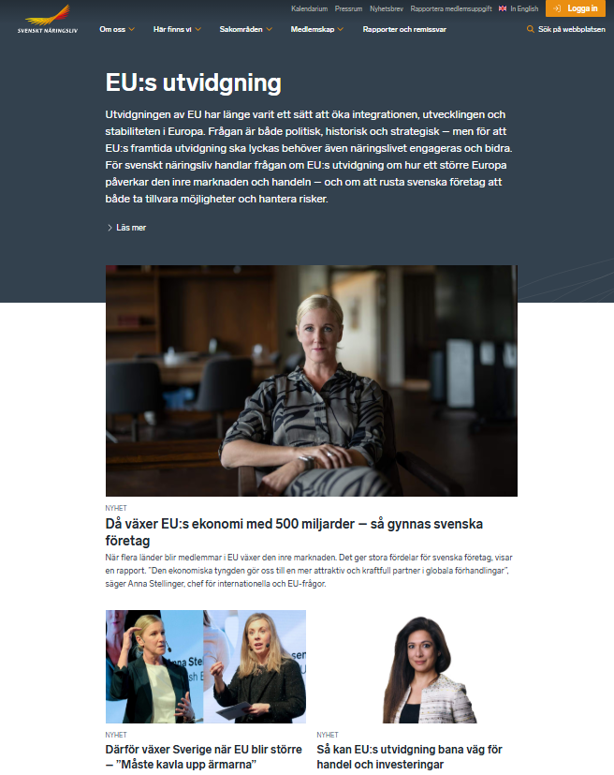
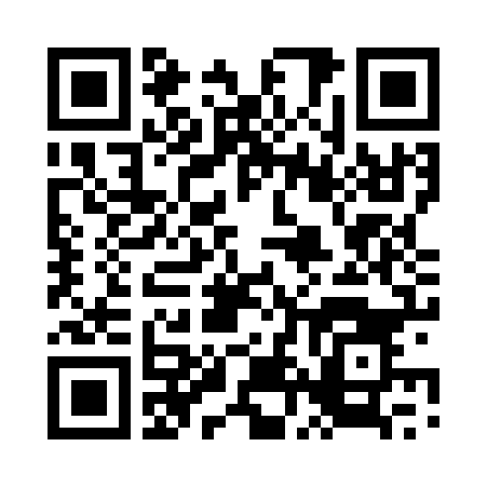
9
Thank you!
Visit our website:
https://www.svensktnaringsliv.se/fraga/eus-utvidgning

