Slide 1



China’s Belt and Road Initiative
Project of the century?
11 April 2019
Viking Bohman

Slide 2
Agenda
What is the Belt and Road Initiative?
Global implications: risks and opportunities
What’s next?

Slide 3
What is the Belt and Road Initiative?
Name? Content? Size?
How it began
  “Silk Road Economic Belt” (land-based)
  “21st Century Maritime Silk Road” (maritime)
Economic projects … part of Xi Jinping’s growing political vision

Slide 4

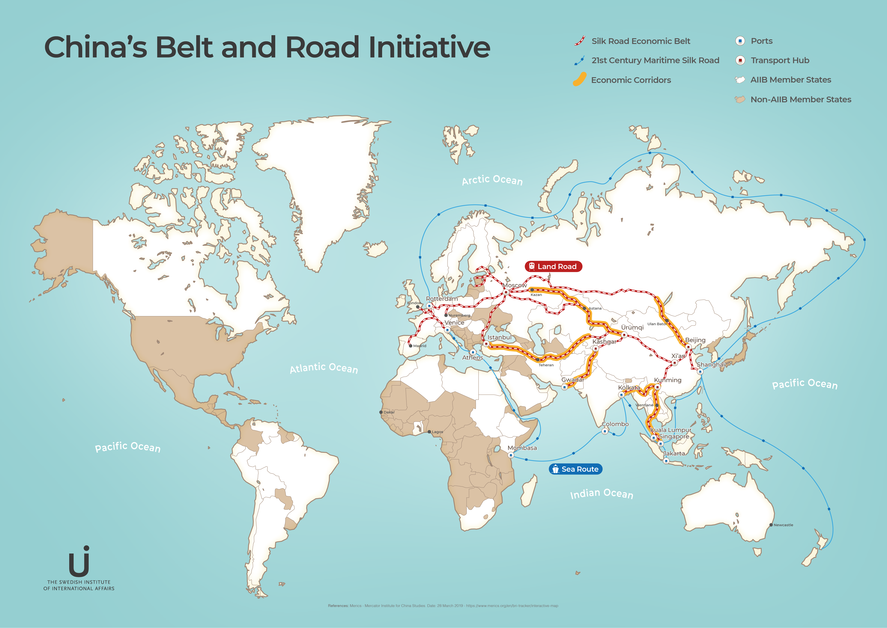

Slide 5
Global implications:
Risks and opportunities
Positive impact
  Lower transaction costs --> more trade, higher growth
Negative impact
  Corruption, environmental degradation, unprofitable projects, ”debt traps”
Political backlash since 2018 but still going strong

Slide 6
What’s next?
Growing US-China rivalry
Strained EU-China relations
The future of the BRI
  Belt and Road Forum (end of April 2019)

Slide 7

Stockholm Observatory for Global China
An independent platform for collaboration and knowledge sharing
for actors in government, civil society and the business sector.
More information: www.ui.se/english/research/asia/sogc
Contact: viking.bohman@ui.se

