Slide 1

SWEDISH INTERNATIONAL DEVELOPMENT COOPERATION AGENCY :
  Collaboration with the private sector
  Reform cooperation in Eastern Europe

Slide 2


Collaboration with the private sector
– Two game-changers from 2015…
.

Slide 3
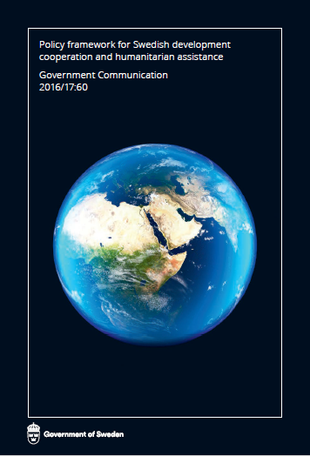
Policy framework for Swedish development cooperation
“Cooperation with business actors in partner countries and internationally is essential to development. This cooperation helps to mobilise both private sector capacity for initiatives, creativity, experience and expertise and its financial resources for sustainable development.
Business has a central role to play in economic development and is essential for job creation. The innovative capacity of companies is central in work to create new, sustainable solutions to global challenges. The same goals and principles apply to cooperation with private actors as to all other development cooperation operations.”

Slide 4
Sida’s cooperation with the private sector
Cooperation with business
Networks and platforms
Challenge
Funds
Public Private Development Partnerships (PPDPs)
Loans and guarantees
Dialogue and influence

Slide 5


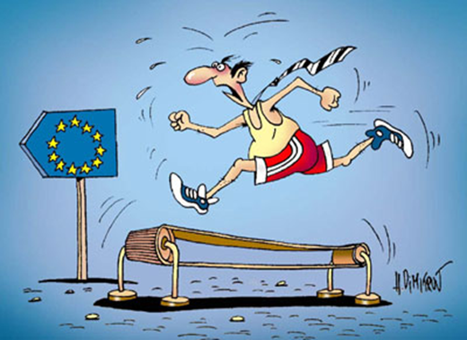






Reform support in Eastern Europe
.

Slide 6

1. Economic development
Increased economic integration with EU and market economic development
2. Democracy and human rights
Strengthening of democracy, increased respect for human rights and more developed constitutional states
3. Environment
Improved environment, limited climate impact as well as a strengthened resistance against environmental effects and climate changes

Slide 7





Economic Development
Women in business
Understanding the Association Agreements
Enabling business environment

Slide 8




ICT for Development
.
– Creating space for innovation and job opportunities for young people in Moldova

Slide 9


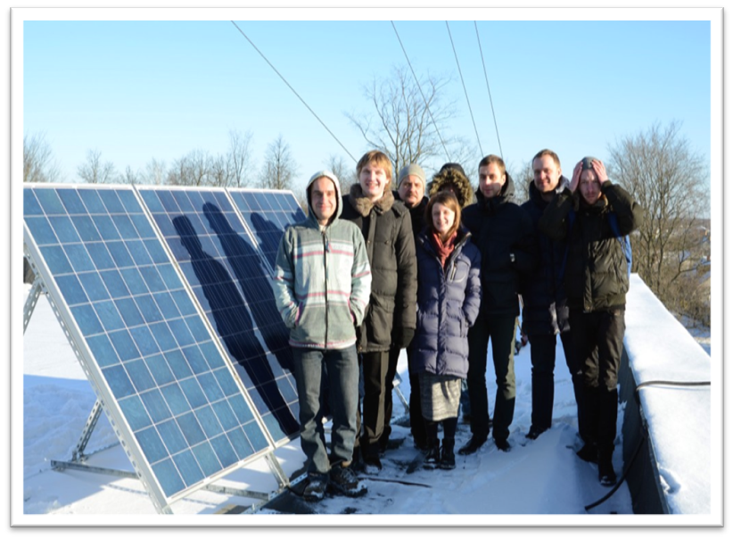


Environment and climate
Energy efficiency and clean water
Joint investments in clean environment projects
.

Slide 10

Thank You!
https://www.sida.se/English/partners

