Slide 1
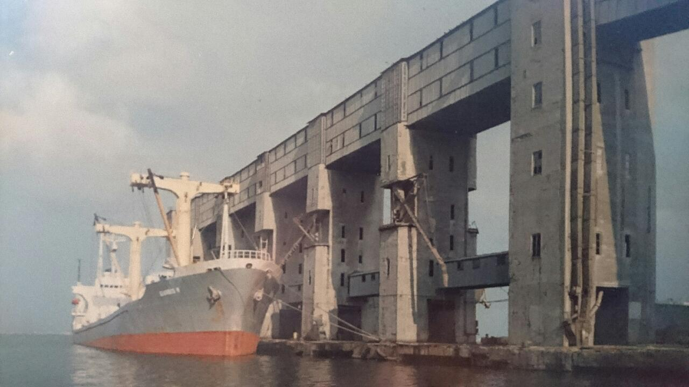

Slide 2
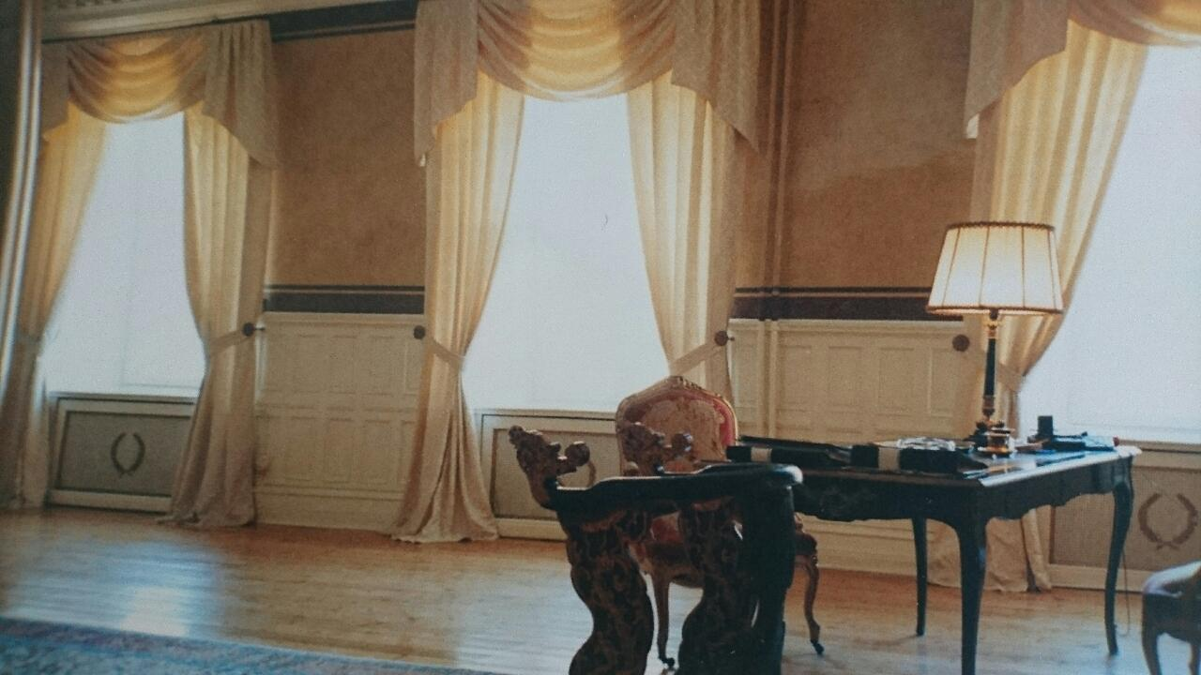

Slide 3
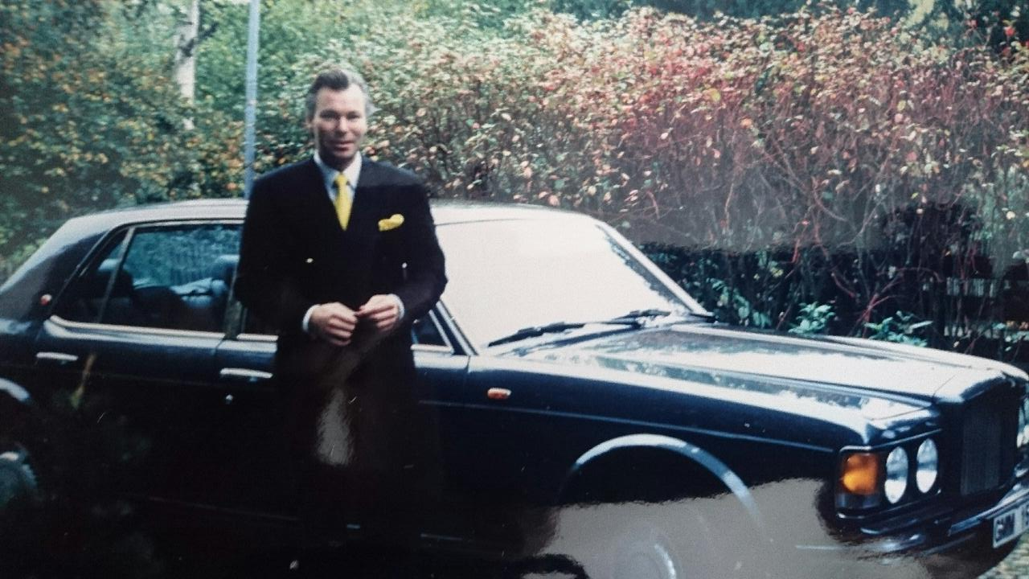

Slide 4
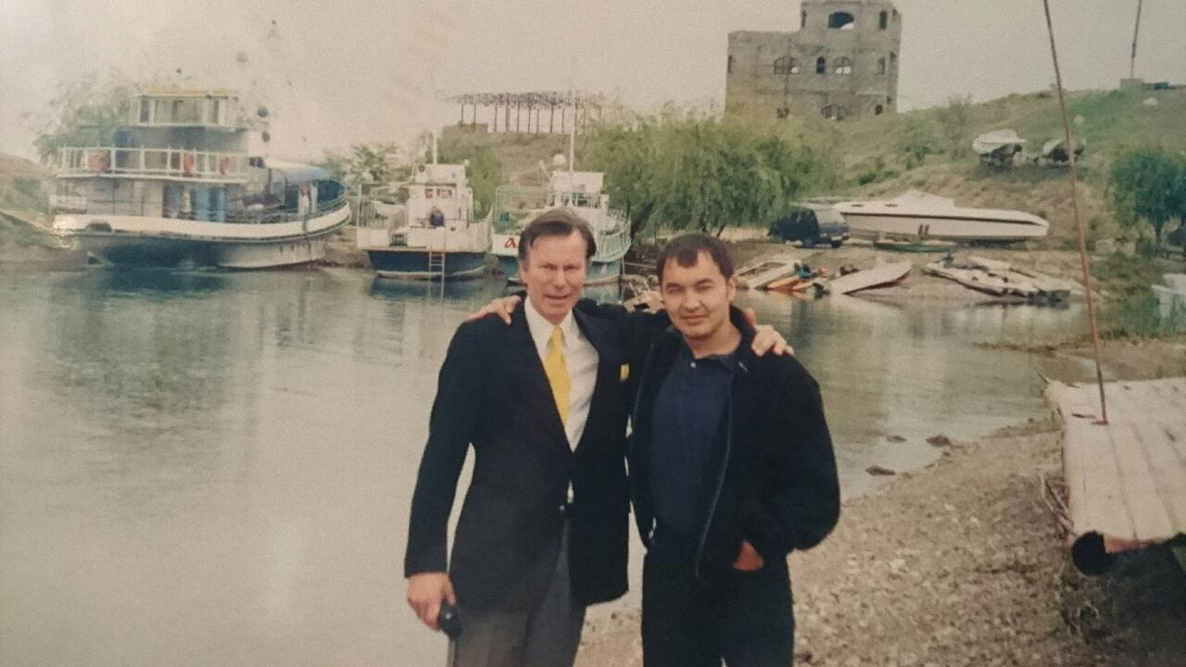

Slide 5
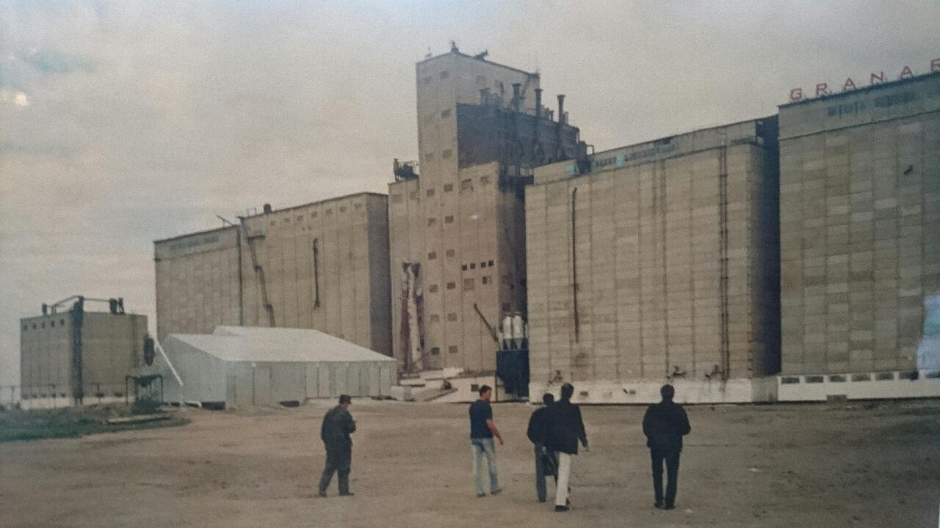

Slide 6
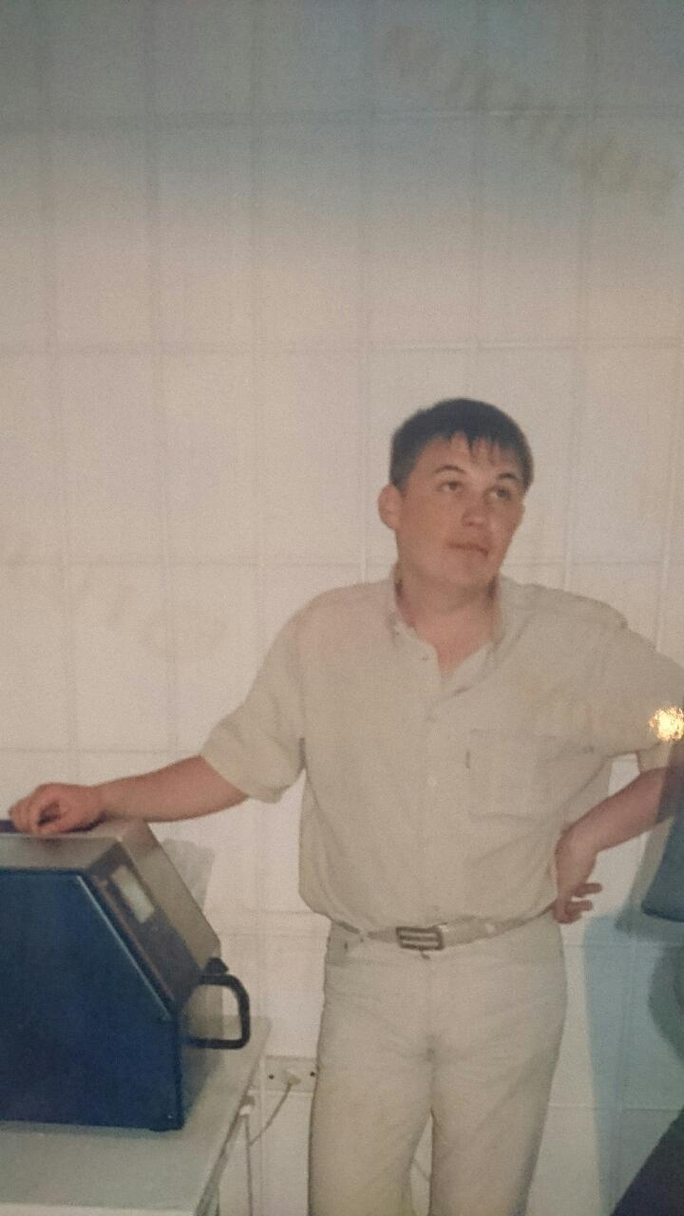

Slide 7
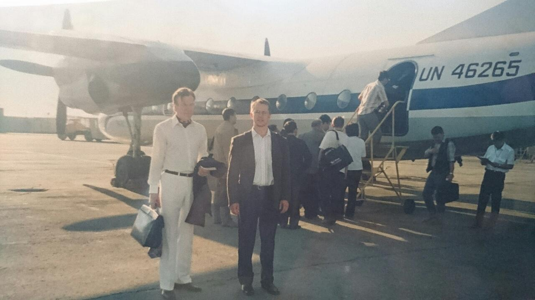

Slide 8
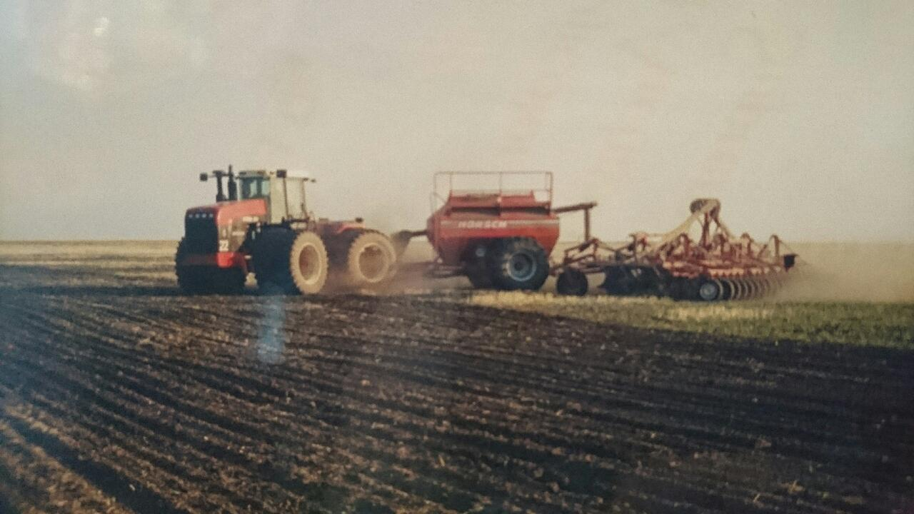

Slide 9
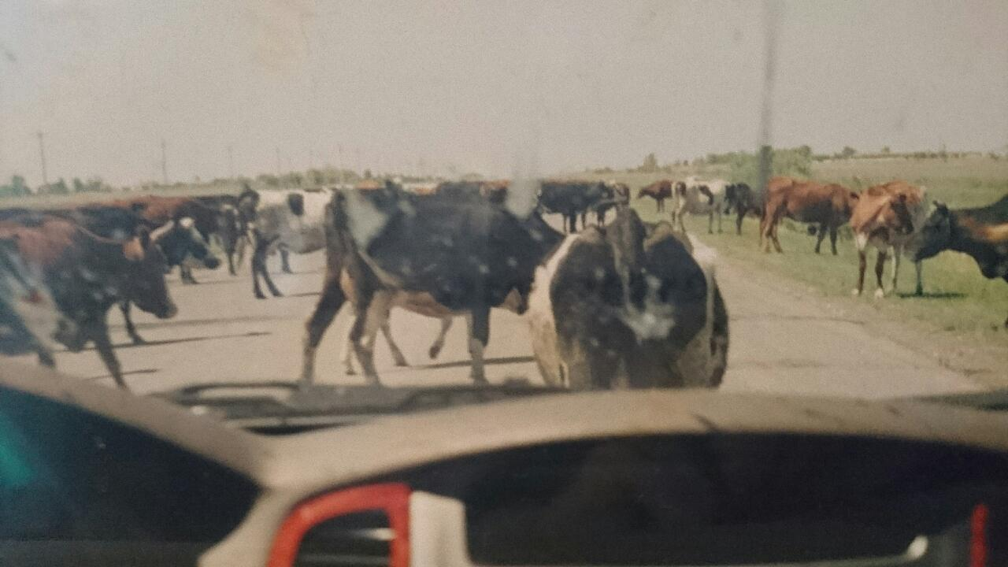

Slide 10
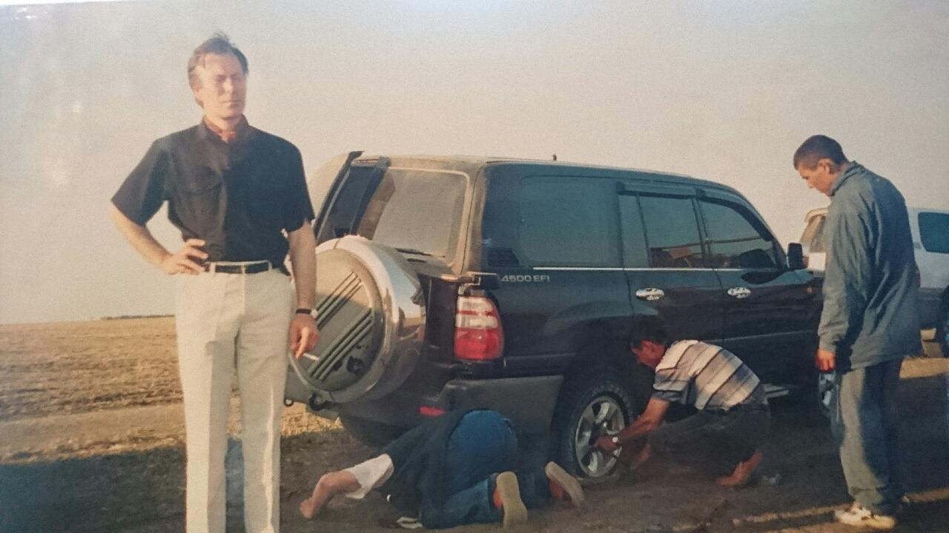

Slide 11
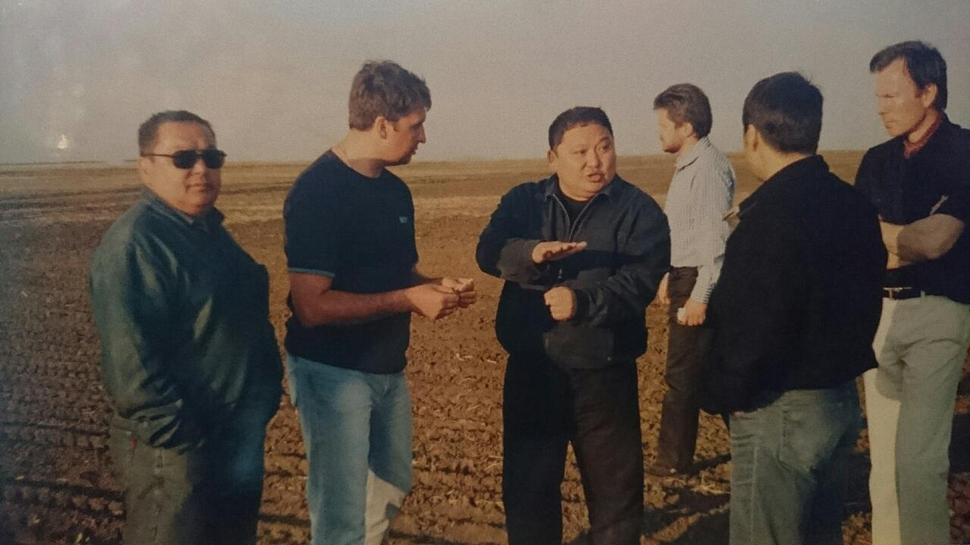

Slide 12
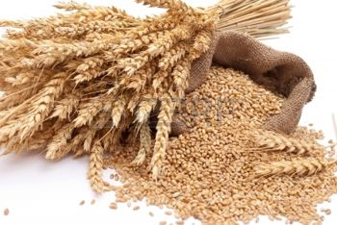


AGROMEAN
GROUP OF COMPANIES
2016

Slide 13

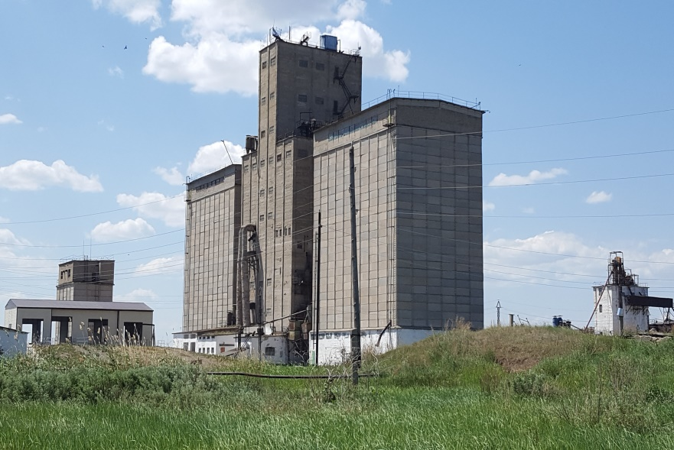

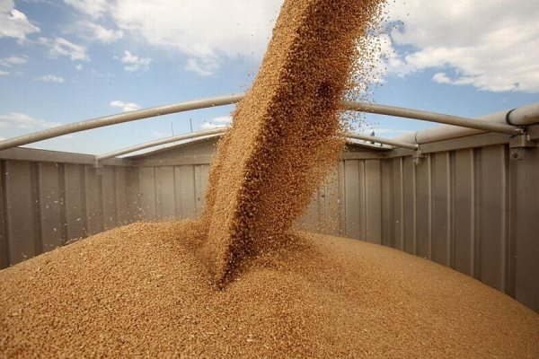
The company has
been operating since 1997.
The main activity of AGROMEAN LLP is export and promotion of Kazakhstan grain, oilseeds and processing products to the global market.

Slide 14
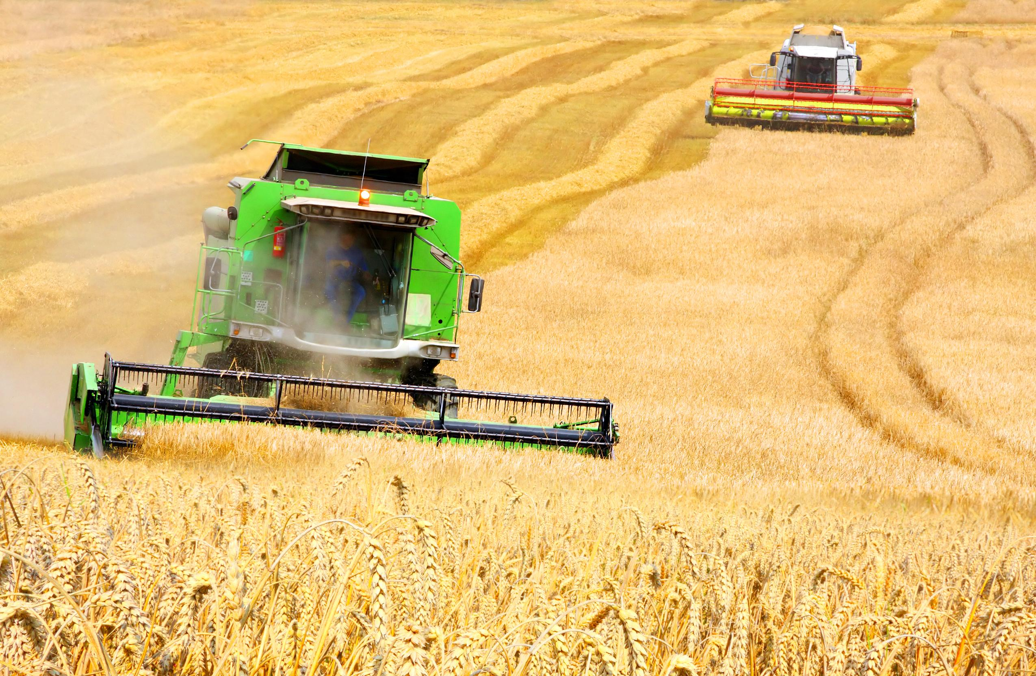
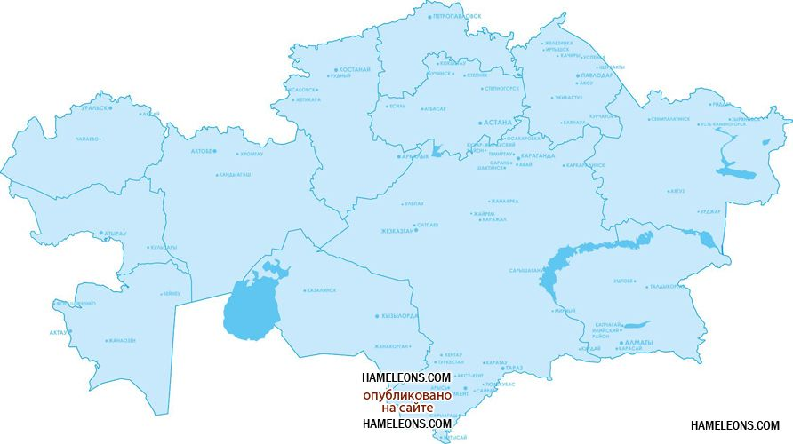
The group of companies includes 10 elevators and 3 flour mill in the major grain-producing regions of Kazakhstan
1 elevator and
1 flour mill in Pavlodar Region.
5 elevators in Kostanay Region
1 elevator and
1 flour mill in North Kazakhstan Region.
2 elevators and
1 flour mill in the Akmola region.
1 elevator in the Almaty region.

Slide 15

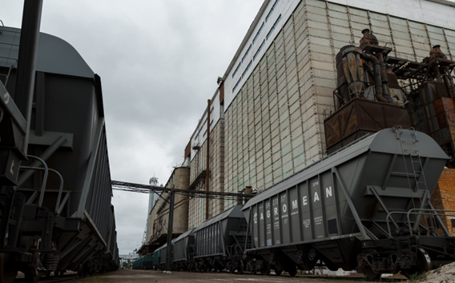
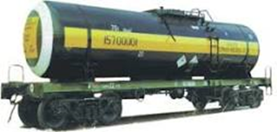
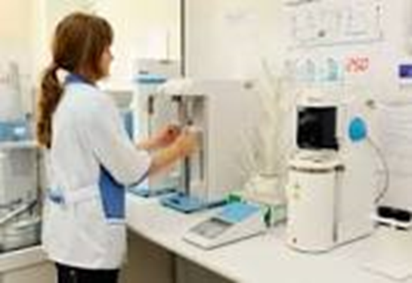
AGROMEAN
The company has its own mobile fleet of new rail cars:
-420 Grain with increased
capacity (110 cubic meters).
-30 Tank for storage and
transportation of vegetable oils.
In December 2013 we had put into operation a modern laboratory, manufactured in Italy, for the determination of more than 200 residues of pesticides, herbicides, insecticides, GMO and salmonella.
The laboratory is unique and the only one in Kazakhstan and Central Asia.
.

Slide 16
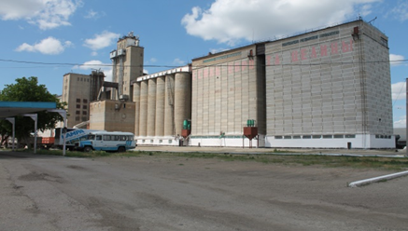
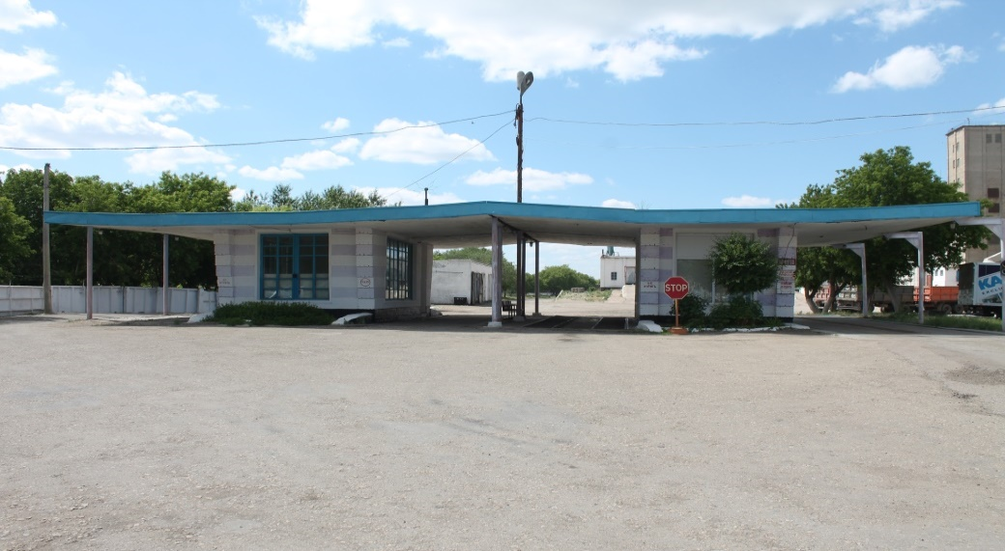
Esil Den LLP
The elevator complex consists of the following:
- Headhouse;
- 6 grain storage sections;
- grain dumps;
- Receiving and crossing device on railway,
- truck and rail way transport weigh houses;
- Grain dryers;
Shipment of grain is carrying out by cars and railway transport.
The company owns a railway deadlock and diesel locomotives for shunting.
Turnover per day is
50 cars.
The peak capacity of grain storage sections and warehouses is
70 000 tons.
The turnover of the elevator per year is more than 130 000 tons.

Slide 17
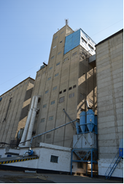
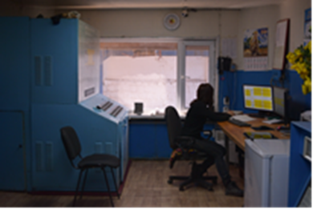
Granart Address: s. Zhanyspay, Karasu District, Kostanay Region, Kazakhstan, Adjacent area: Karasu District
The main activity of the company is receiving, drying, pre-treatment and distribution of grain.
The elevator has been built and put into operation in 1961.
Total area is 15,76 hectares.
The elevator complex consists of the following:
- Headhouse;
- 5 grain storage sections;
- grain dump;
- Receiving and crossing device on
railway,
- Road and rail weigh houses
- Grain dryer.

Slide 18
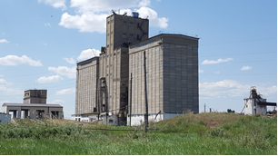
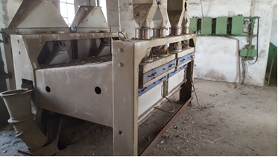
Nordstock LLP Address: Druzhba Vill., Karasu District, Kostanay Region, Kazakhstan Adjacent area: Karasu District
The main activity of the company is receiving, drying, pre-treatment and distribution of grain. The elevator has been built and put into operation in 1972.
Total area is 14,0 hectares.
The elevator complex consists of the following: - Headhouse; - 2 grain storage sections; - grain dump; - Receiving and crossing device on
railway,
- Road and rail weigh houses
- Grain dryer in headhouse.

Slide 19
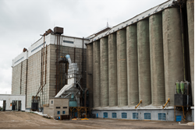
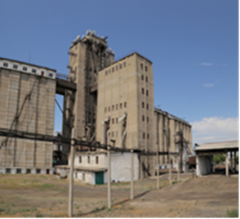
Agrostock LLP Address: Kazanbasy st., Auliekol District, Kostanay Region, Kazakhstan Adjacent area: Auliekol District, Nauyrzym District,
The main activity of the company is receiving, drying, pre-treatment and distribution of grain.
Grain point enterprise had been put into opertion in 1959.
Total area is 14,29 hectares.
The elevator complex consists of the following:
- eight fully mechanized granaries with floor storage;
- grain dump;
- Receiving and crossing device on railway;
- truck and railway weihg house;
- grain dryer.

Slide 20
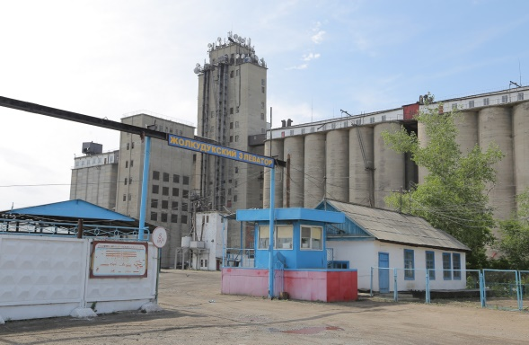
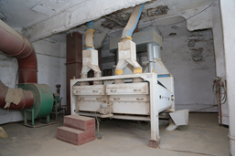
Zholkuduksky elevator LLP Address: 1 Tselinnaya str., Leninky vill, Pavlodar city, Kazakhstan Adjacent area: Zhelezinsky district, Irtyshsky district
The main activity of the company :
receiving, drying, pre-treatment and distribution of grain, starchy food production, buckwheat processing .
The elevator has been put into operation in 1959.
Total area is 24,49 hectares.
The elevator complex consists of the following:
- 4 grain storage sections;
- Headhouse;
- grain dump;
- Receiving and crossing device on railway;
- truck and railway weihg house;
- grain dryer.

Slide 21
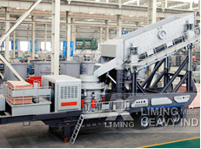
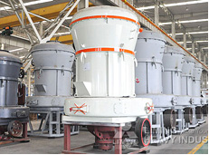
Zholkuduksky elevator LLP
В The property of the enterprise are the following:
3 warehouses to accommodate the goods and 2 warehouses for the by-products;
railway line;
locomotive for shunting.
Car turnover per day is
45.
The peak capacity of grain storage sections and warehouses is 70 000 tons.
The turnover of the elevator per year is 85 000 tons.
ANA 2000 a flour mill made in Turkey is located in the elevator.
Capacity of the complex is 100 tons per day.
There is a section for the buckwheat processing at the elevator as well. Performance of the section is 12 tons / per a day.

Slide 22
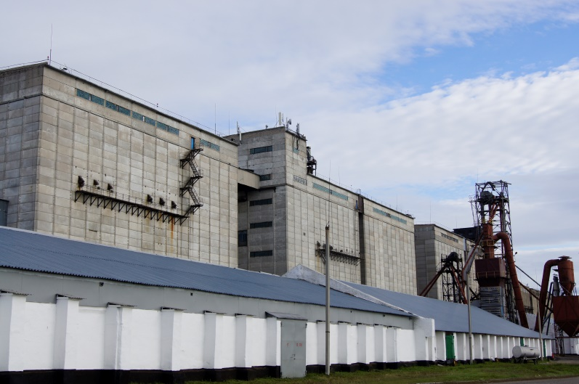
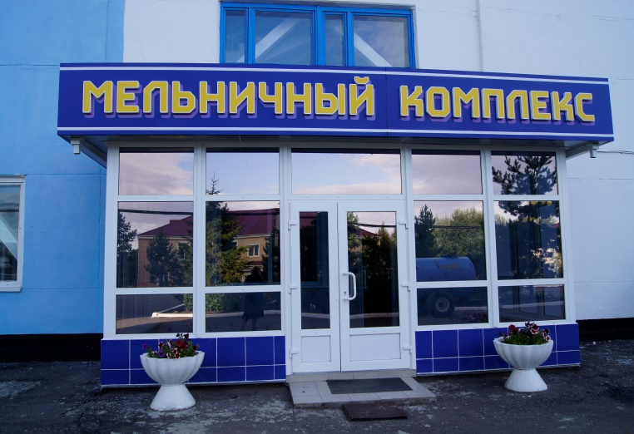
Mamlyutsky flour mill LLP Address: 37, Skachkov str., Mamlyutka town, North Kazakhstan Region Adjacent area: Mamlyutka disrtict, Zhambyl disrtict
The main activity of the company :
receiving, drying, pre-treatment and distribution of grain, starchy food production.
The elevator has been built put into operation in 1956.
Total area is 12,8 hectares.
The basis of the production activities of the elevator is the following:
- Modern mill complex;
-elevator;
- Complex mechanized grain storage sections.
The elevator complex consists of the following:
- Headhouse;
- 6 grain storage sections;
- 17 fully mechanized granaries with floor storage;
- grain dump;
- Receiving and crossing device on railway;
- truck and railway wegh house;
- grain dryer.

Slide 23
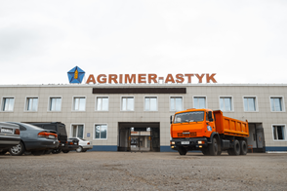
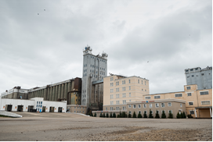
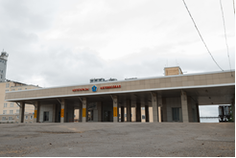
Agrimer-Astyk LLP Address: 5 Suleymenov str, Kokshetau city, Kazakhstan Adjacent area: Zerenda district Sandyktau District, Burabay district
Grain-point enterprise had been put into operation in 1924.
Total area is 22,5 hectares.
The elevator complex consists of the following:
- 4 grain storage sections;
- 15 fully mechanized granaries with floor storage;
- Headhouse;
- grain dump;
- Receiving and crossing device on railway;
- truck and railway weigh house;
- grain dryer.

Slide 24
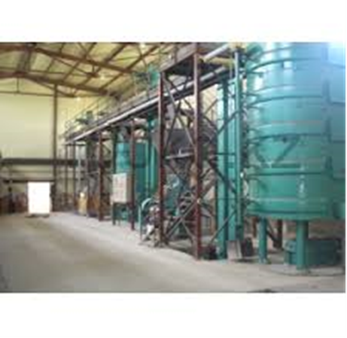
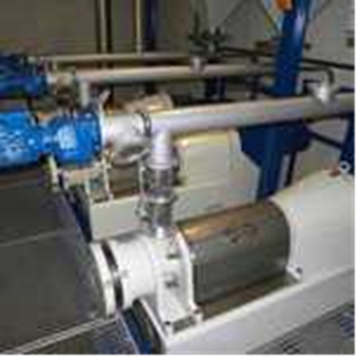
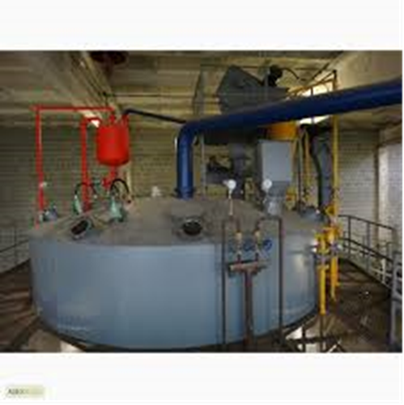
Agrimer-Astyk LLP
Agrimer-Astyk Elevator has multiple lines (plants) for the processing of oilseeds :
- Soybeans processing plant with capacity of 30 000 tons of raw material per year. Exports of soybean products (soybean meal and soybean oil) is 90%, the remaining 10% is selling on the domestic market;
Plant for the production of extruded soybean (Full-fat soybeans).
The performance of the plant is 22,000 tons of raw material per year.

Slide 25
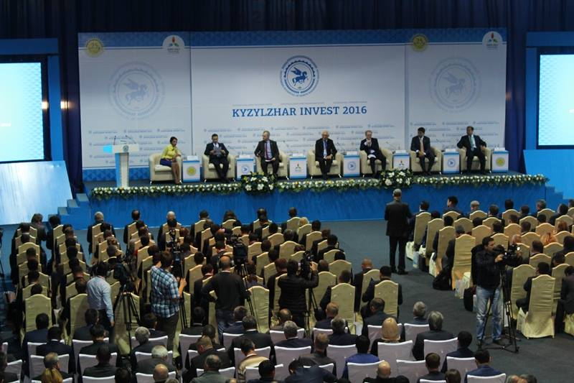

Slide 26
